Slide 1

Online E Commerce Book Store
By,
Sudhanshu Pandey
Rajat Bisht
Shobhit Pathak
Praful Joshi

Slide 2

INTRODUCTION
E commerce growth
Convenient and Accessible
Focus on development
This Photo by Unknown author is licensed under CC BY-SA-NC.

Slide 3

OBJECTIVE
User friendly
Rich E-Commerce website
Seamless online shopping Experience.
Wide Range of Books for Book Enthusiasts.
This Photo by Unknown author is licensed under CC BY-NC-ND.

Slide 4

SCOPE
Development of a comprehensive e-commerce book store website.
User registration and login.
Product Cataloguing
Search Option
Cart Shopping
Secure Payment Options
Administrative Page
Secure Database
This Photo by Unknown author is licensed under CC BY-NC.

Slide 5

METHEDOLOGY
Development methodology will be followed
Improvement and adaptation based on user feedback
Appropriate project management techniques
Aim to tap into the growing demand for online book
Providing a user-friendly platform for book enthusiasts
This Photo by Unknown author is licensed under CC BY-SA-NC.

Slide 6
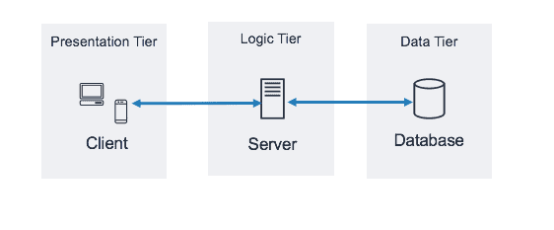
ARCHITECTURE DESIGN

Slide 7
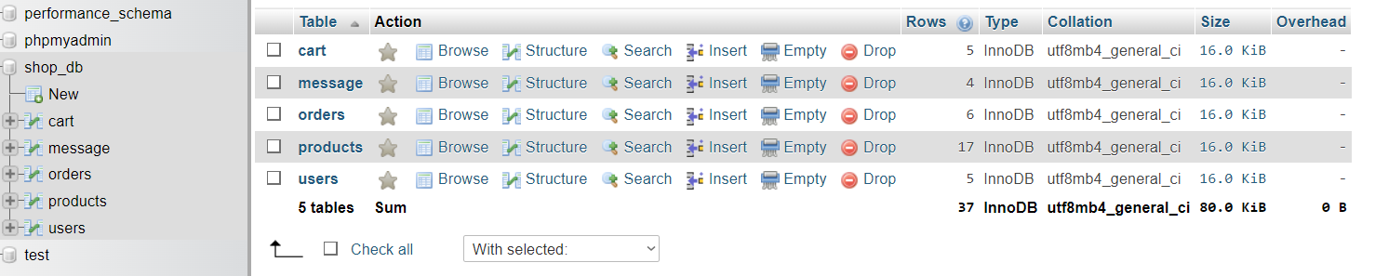
DATABASE DESIGN

Slide 8
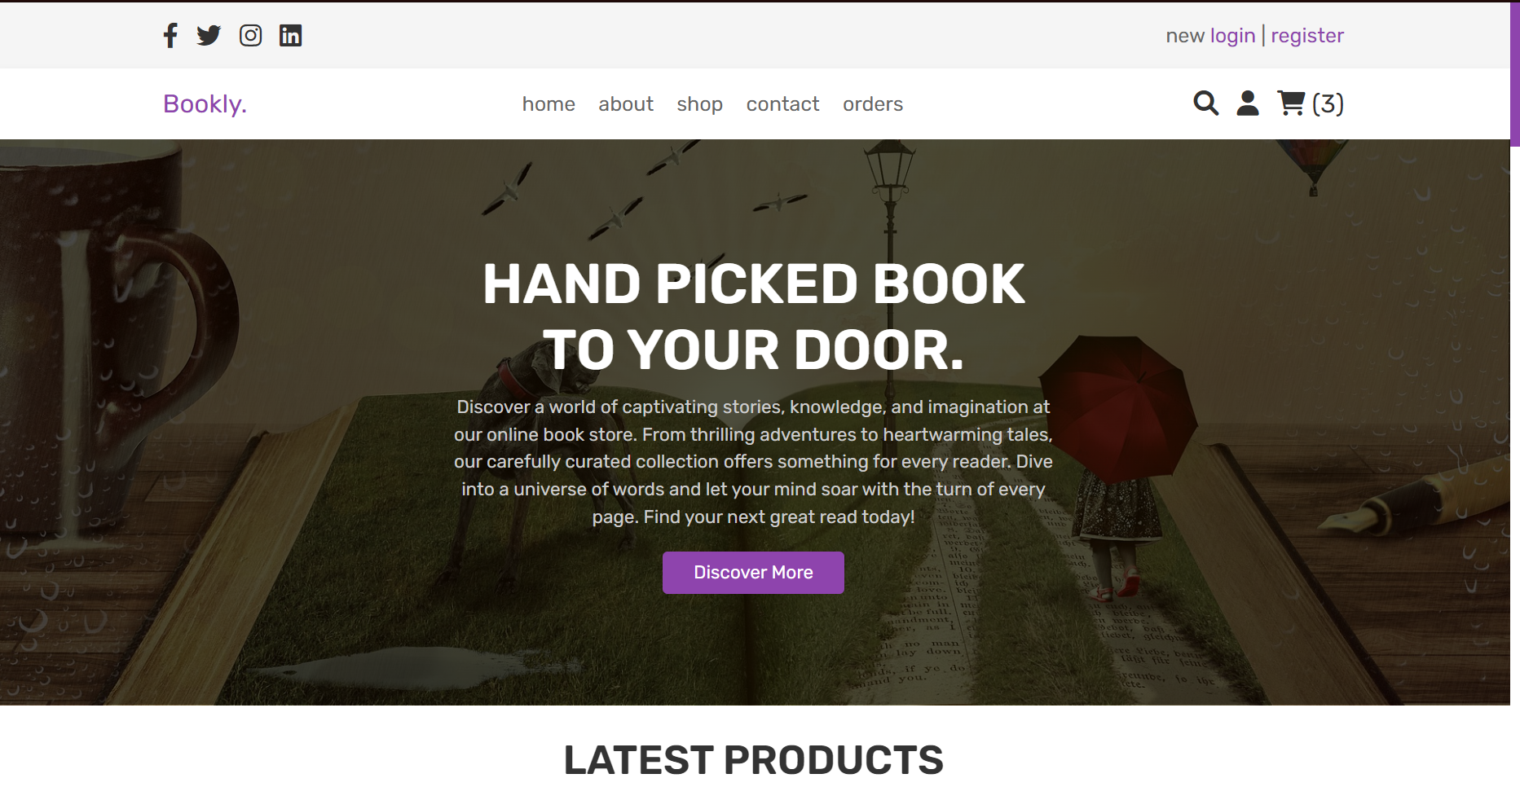
USER INTERFACE DESIGN

Slide 9

FEATURE AND FUNCTIONALITY
Registration and Login
Search and Filter
Shopping Cart and Checkout
Admin Panel
This Photo by Unknown author is licensed under CC BY-NC.

Slide 10
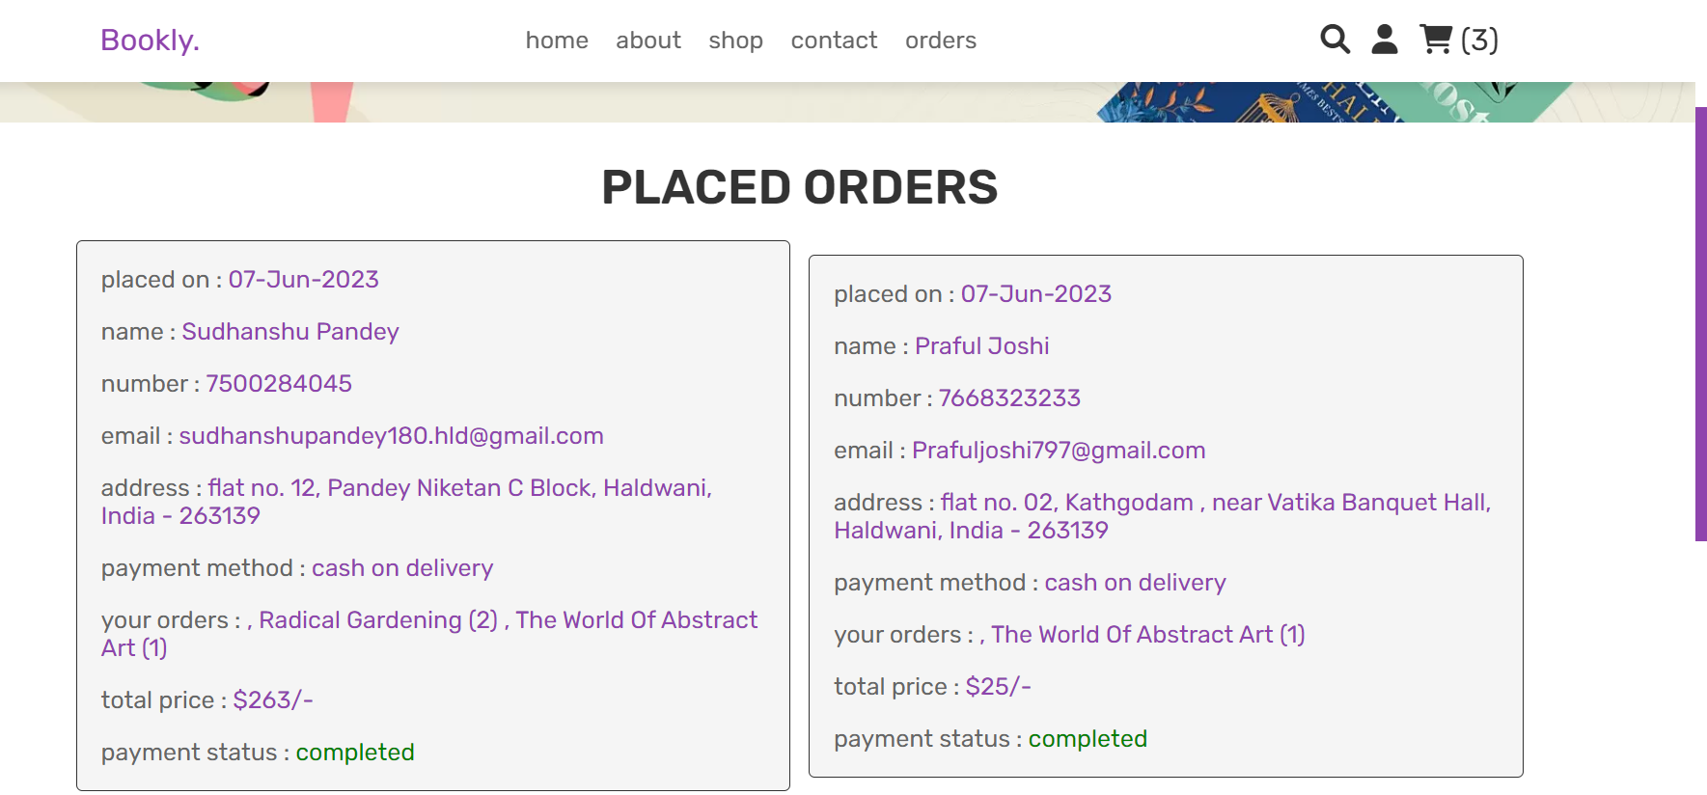
USER PORTAL OUTPUT

Slide 11
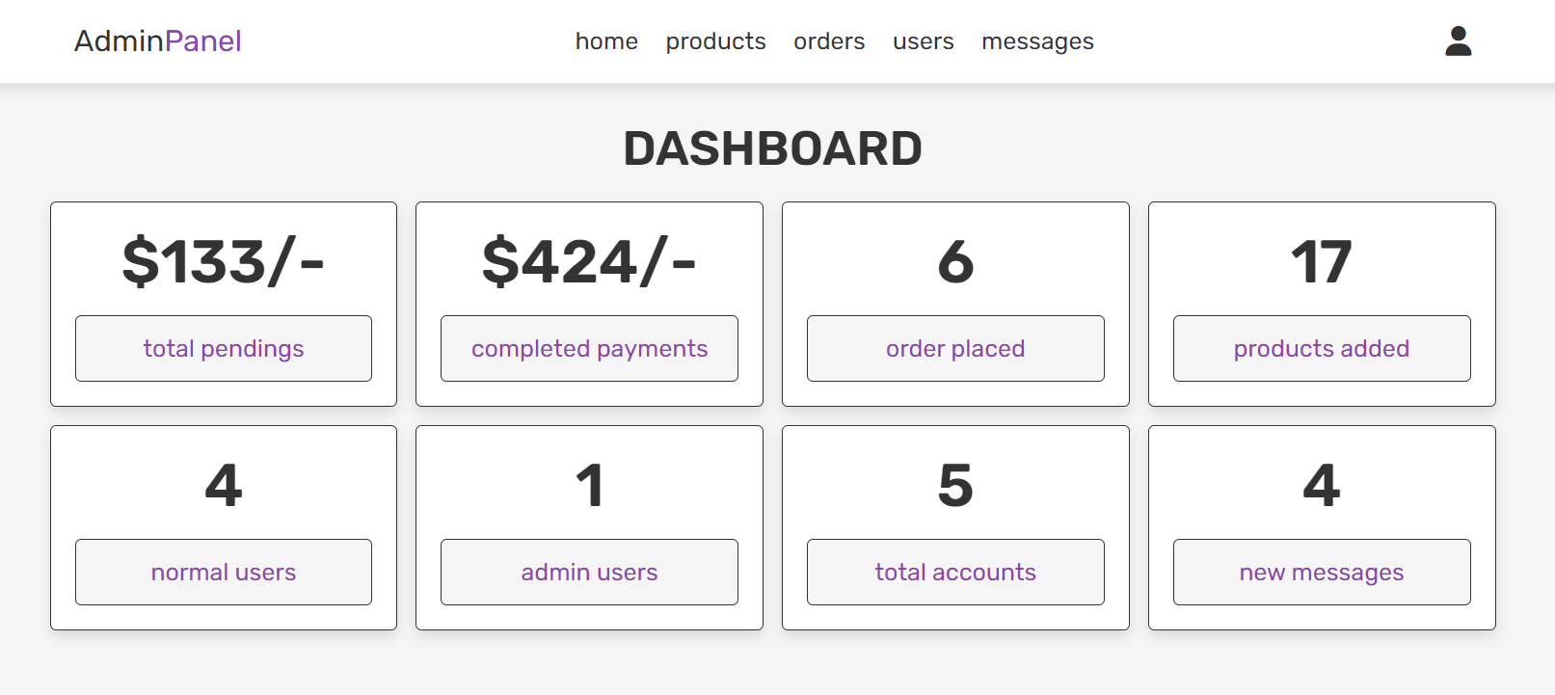
ADMIN PORTAL OUTPUT

Slide 12
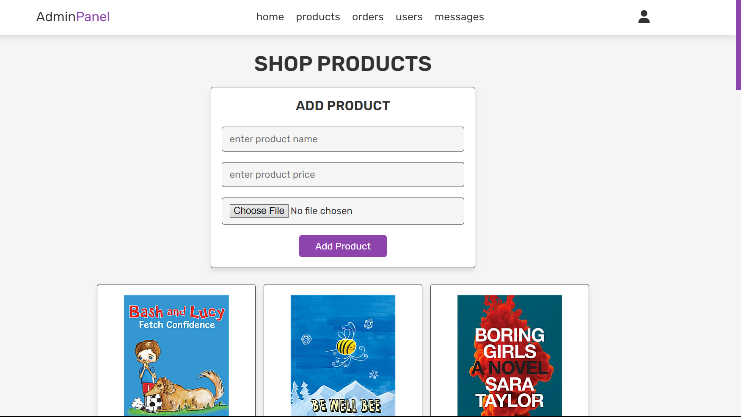
PRODUCT INSERTION PAGE

Slide 13
THANK YOU

